Slide 1
Chapter 10
Software
Engineering

Slide 2
OBJECTIVES
After reading this chapter, the reader should
be able to:
Understand the software life cycle.
Describe the development process models.
Understand the concept of modularity in software engineering.
Understand the importance of quality in software engineering.
Understand the role of documentation in software engineering.

Slide 3
Contents
10.1 Software life cycle
10.2 Development process models
10.3 Modularity
10.4 Quality
10.5 Documentation
Summary

Slide 4
Software engineering is the establishment and use of sound engineering methods and principles to obtain reliable software that works on real machines.

Slide 5
10.1
SOFTWARE
LIFE
CYCLE
软件生命周期

Slide 6
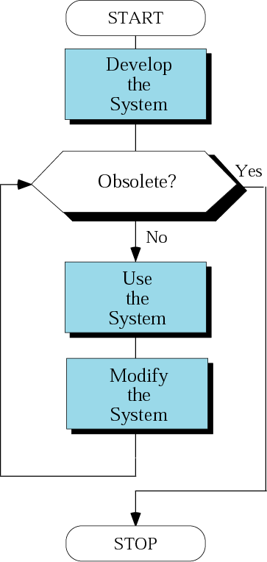
Figure 10-1
System life cycle
Software life cycle

Slide 7
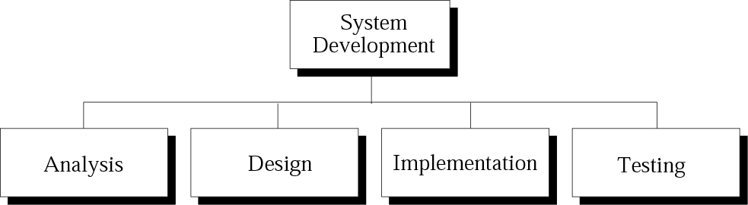
Figure 10-2
System development phases
What?
How?
Doing
OK?
Define:
(1)Users
(2)Needs
(3)Requirements
(4)Methods
(1)Determing the systems
(2)Designing the files,databases
Modularity
Structure chart/UML
(1)Flowchart/Pseudocode
(2)Coding
(1)Black Box Testing
By test enginer
(2)White Box Testing
By programmer

Slide 8
10.2
DEVELOPMENT
PROCESS
MODELS
开发过程模型

Slide 9
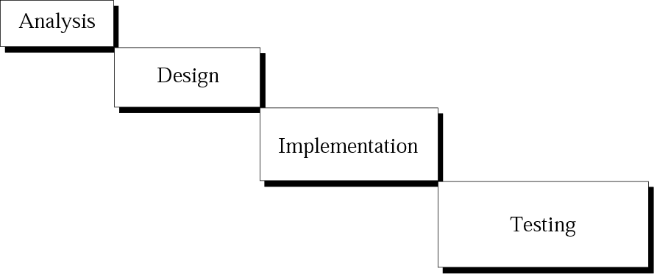
Figure 10-3
Waterfall model
Each module is completely finished before the next module is tarted.

Slide 10
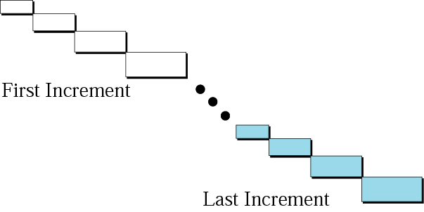
Figure 10-4
Incremental model
The entire package is constructed, with each module consisting of only a shell; the modules gain complexity with each iteration of the package.

Slide 11
10.3
MODULARITY
模块化

Slide 12
Modularity is the division of a large program into smaller parts that can communicate with each other.
  Coupling is a measure of how tighly two modules are bound to each other. The types of coupling include data,control,global, and content.
  Cohesion is a measure of how closely the processes in a program are related. The types of cohesion include functional,sequential,communication,procedural,temporal,logical, and coincidental.
  Low Coupling, High Cohesion.

Slide 13
10.4
QUALITY
(软件)质量

Slide 14
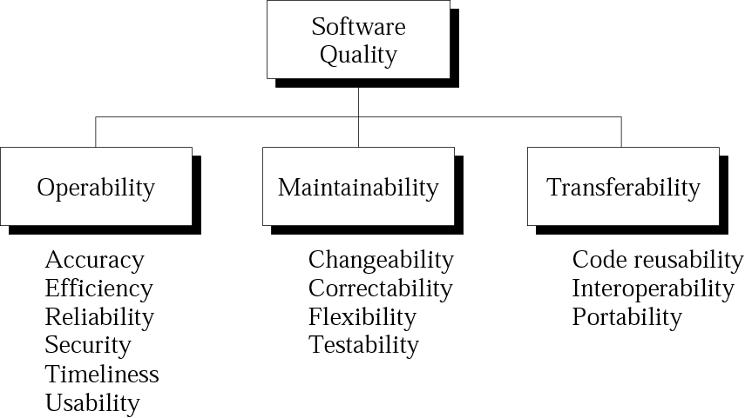
Figure 10-5
Quality factors
可操作性
可维护性
可移植性

Slide 15
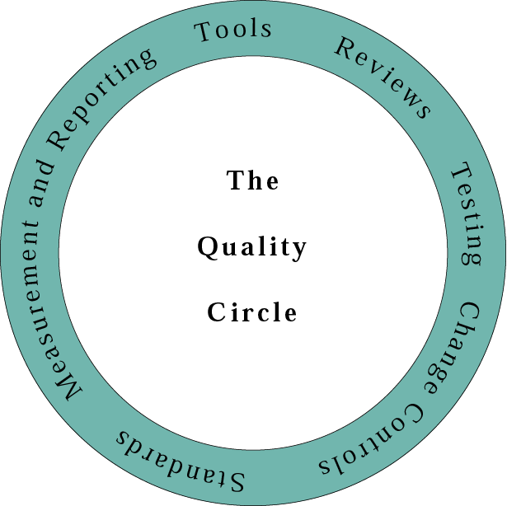
Figure 10-6
Quality circle
There are six steps to quqlity software:
Quality tools
Technical review
Formal testing
Change controls
Standards
Measurement and reporting

Slide 16
10.5
DOCUMENTATION
文档

Slide 17
User Documentation
System Documentation
  Documentation in the Analysis Phase
  Documentation in the Design Phase
  Documentation in the Implementation Phase
  Documentation in the Testing Phase
  Documentation as an ongoing process

